Slide 1
Greenhouse menace
The educational memory game for 11-16 year olds

Slide 2
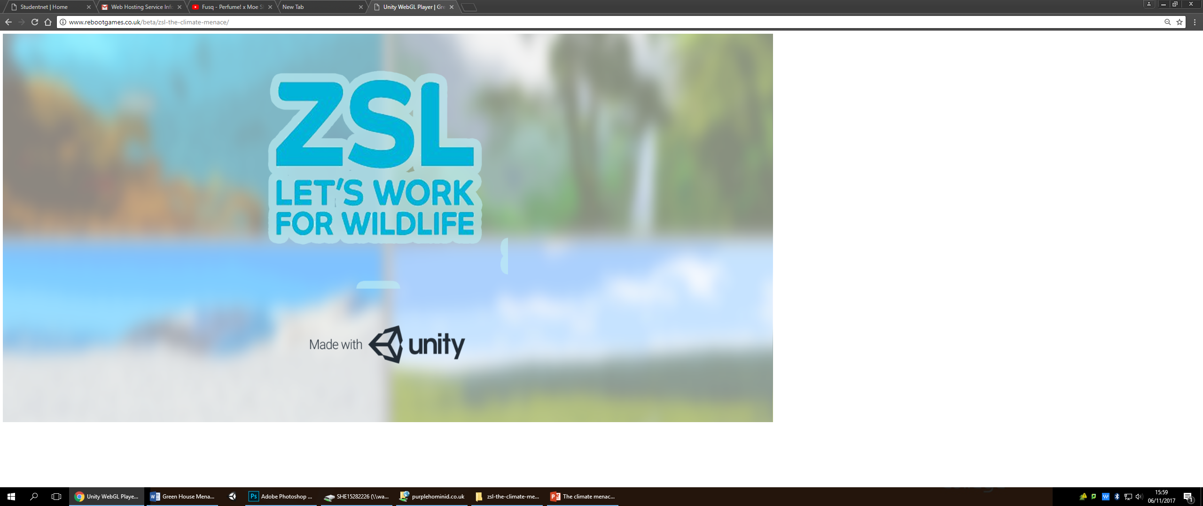
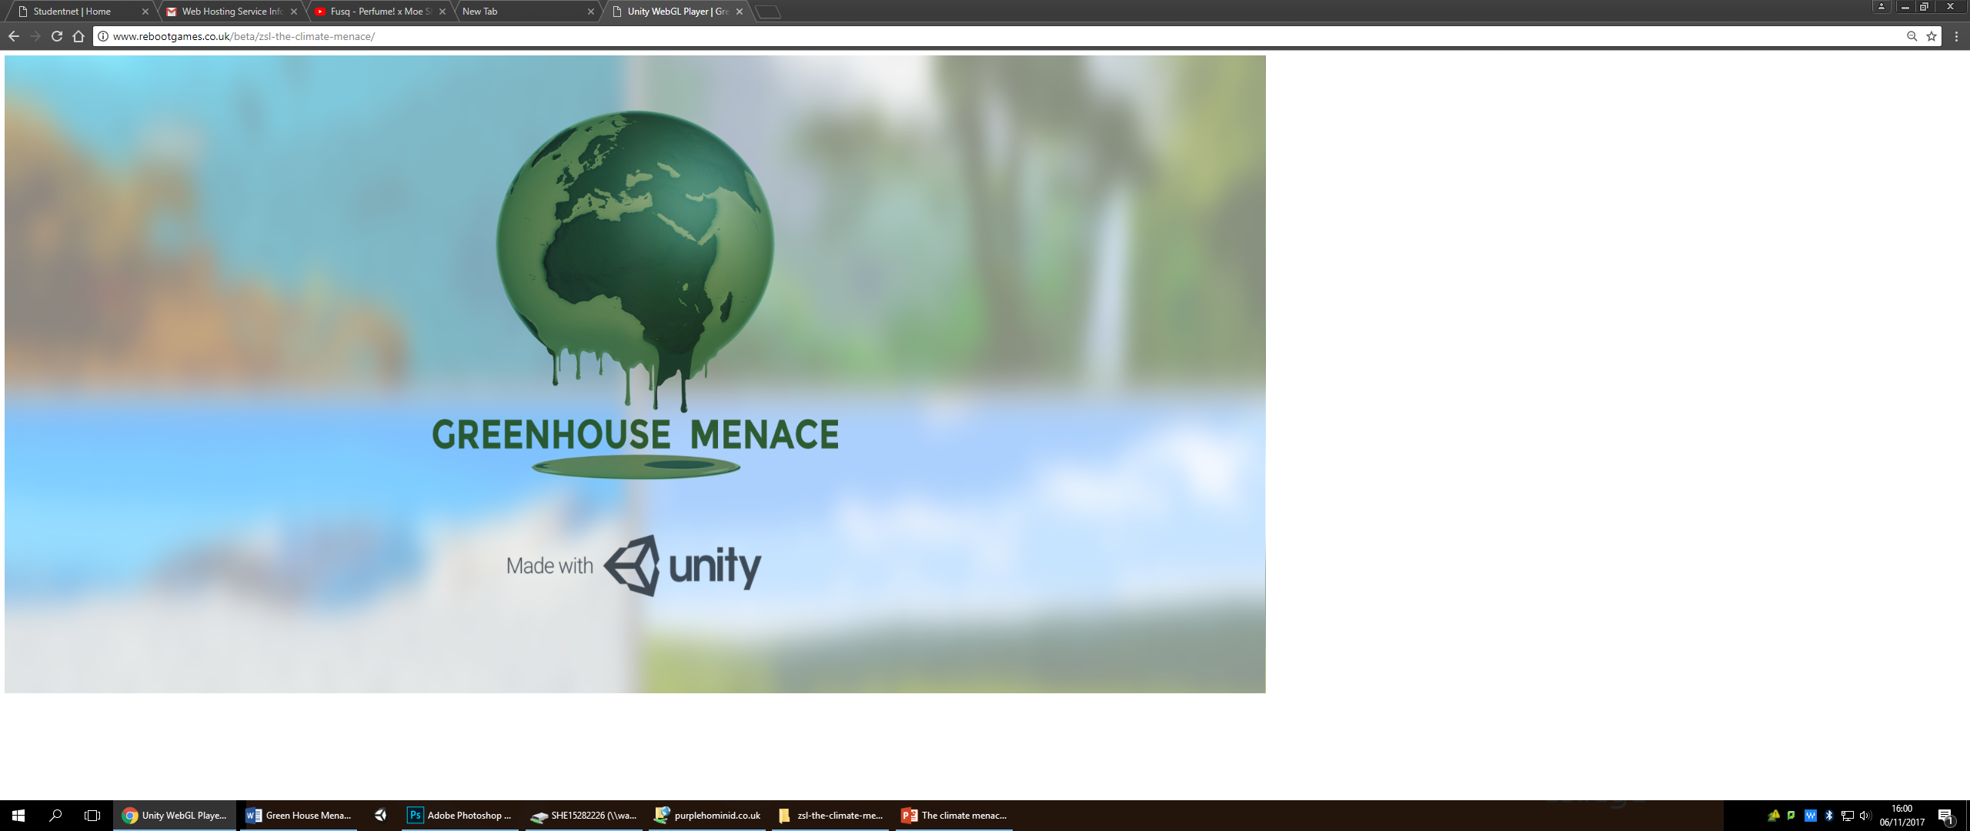
Starting the App
Upon startup ZSL logo will appear.
Affiliation with brand to app.
Greenhouse menace will follow ZSL logo.
Giving credit to engine with Unity.

Slide 3
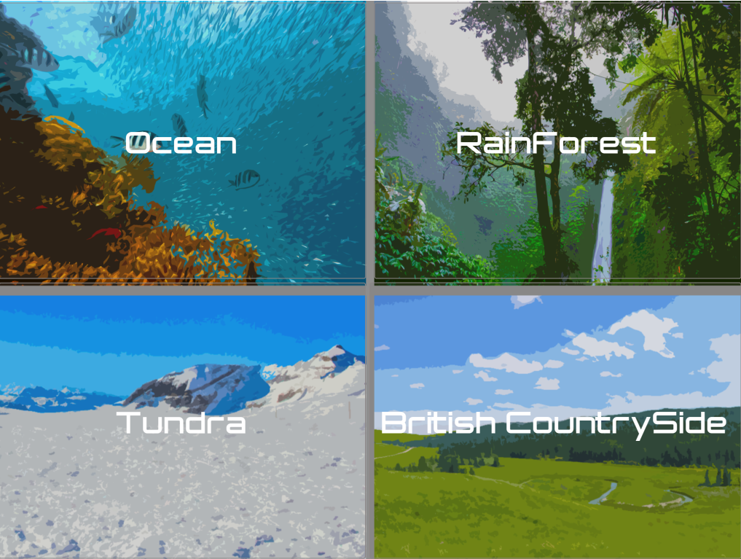
The menu
The 4 habitats will be shown clearly.
Tundra (Arctic), British wildlife, Ocean and Rainforest.
User chooses habitat dependent on table.
Specified items for each habitat.

Slide 4
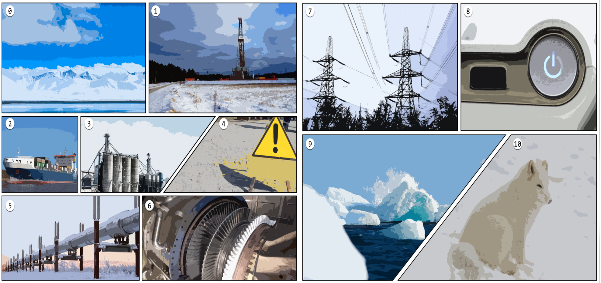
Comic Book Strip
Tundra habitat example.
Process is shown briefly as an overview.
Shows images that will be used.

Slide 5
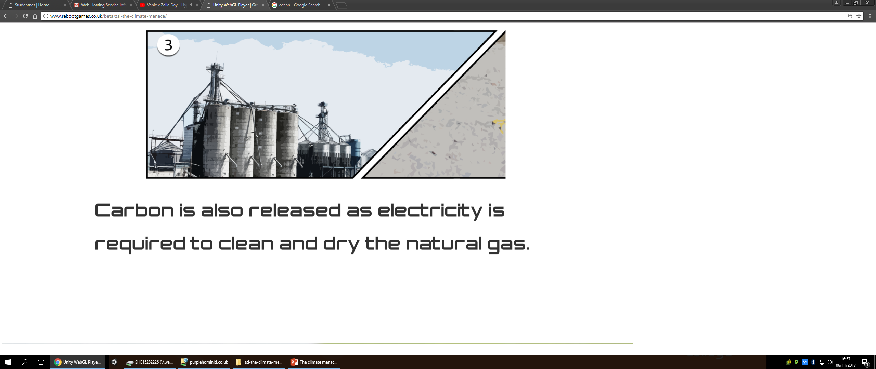
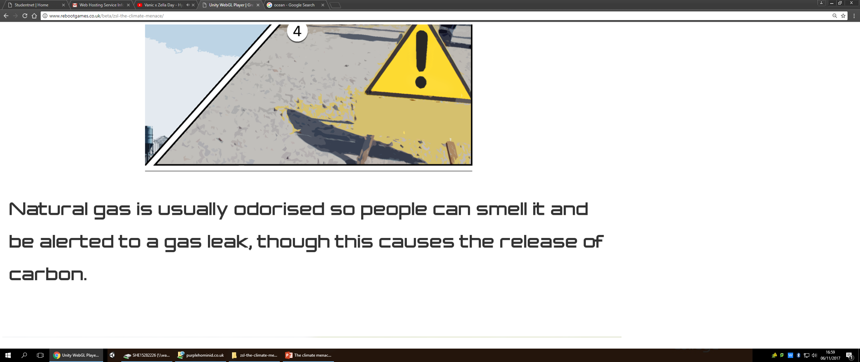
Comic continues
Individual slides are shown.
Short bits of information to take in.
5-7 seconds for information.
Information will be referred back to.

Slide 6
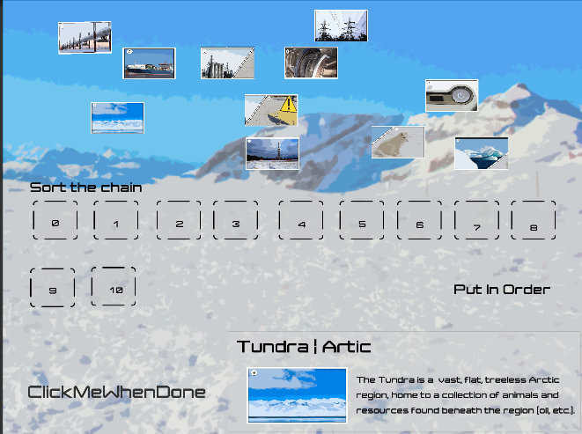
Drag and drop memory game
Comic will transition into game.
The game will be memory based.
User must connect images to designated point.
Must build the chain of process.
If incorrect it is pushed out.
PENis

Slide 7

Drag and drop continued
Order of chain will be stuck when correct.
Information for image when attempt.
Info appear below the chain.

